Slide 1
Bright Network Technology Academy
Framework for Onboarding and Ongoing Support
May 2022

Slide 2
Testing
What, why, how?
May 2022

Slide 3
What is testing?
Method to check whether the actual software product matches expected requirements and is defect free
Notes:
Software Testing is a method to check whether the actual software product matches expected requirements and to ensure that software product is Defect free. It involves execution of software/system components using manual or automated tools to evaluate one or more properties of interest. The purpose of software testing is to identify errors, gaps or missing requirements in contrast to actual requirements.

Slide 4
What is testing?
Method to check whether the actual software product matches expected requirements and is defect free
It involves execution of software/system components using manual or automated tools to evaluate one or more properties of interest
Notes:
Software Testing is a method to check whether the actual software product matches expected requirements and to ensure that software product is Defect free. It involves execution of software/system components using manual or automated tools to evaluate one or more properties of interest. The purpose of software testing is to identify errors, gaps or missing requirements in contrast to actual requirements.

Slide 5
Why do we test?

Slide 6

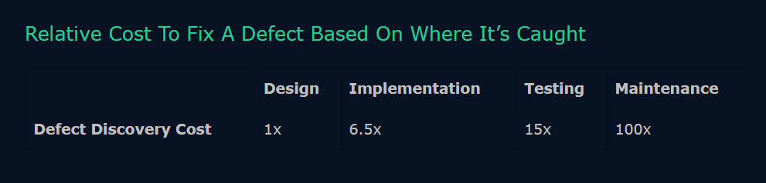
Benefits of Testing
Cost-Effective
Testing any IT project on time helps you to save your money for the long term. In case if the bugs caught in the earlier stage of software testing, it costs less to fix
Notes:
McDonald’s glitchy giveaways
What: Not all software issues kill (people or democracy). In 2019, two Australians made headlines for a trick they discovered with the pricing at the fast food giant’s ordering kiosks that netted them a free burger. It wasn’t a hack as it was widely called. They just exploited the system to their own benefit. But, a quick search of the internet reveals this isn’t the only time McDonald’s has unwittingly given food away. It seems users of the app are often able to add items priced at $0.00 to their carts.
Why: There is no such thing as “system failure,” only human failure. The Australians simply did the math - if an item price is reduced by more than the cost, you get free stuff. In the case of the app, it seems the freebies happen after a person either doesn’t program a price on an item or they neglect to disable ordering for an item that isn’t on the store menu.

Slide 7

Benefits of Testing
Security
People are looking for trusted products. Testing helps identify and address risks and problems earlier.
Notes:
Toyota ‘botched’ software processes
What: Off-duty highway patrolman Mark Saylor and three family members were among the first known victims whose fatal high-speed car crashes caused by a jammed accelerator pedal. Eventually, nearly 100 lives were lost. The manufacturer, Toyota, eventually paid a $1.2 billion fine and recalled millions of cars, including Lexus and Pontiac vehicles.
Why: An initial NTSB investigation found no electrical defect, and instead blamed a combination of the drivers and incorrectly-installed floor mats. However, a longer investigation followed, and after 18-months, embedded systems expert Michael Barr revealed the litany of problems he’d uncovered. Toyota’s software had failed to perform run-time stack monitoring, “botched” its worst-case stack depth analysis, used “spaghetti” code, critical variables weren’t prevented for corruption and more besides, remarking: “There is a process in place for hardware but not software.”

Slide 8

Benefits of Testing
Product Quality
Well-defined tests bake quality into a software product.
Testing ensures a quality product is delivered to customers

Slide 9

Benefits of Testing
User Satisfaction
The main aim of any product is to give satisfaction to its users.
UI/UX Testing ensures the best user experience
Notes:
Studies shows that 95% of customers who experience a bad product interaction will share it with their friends.
Facilitator may make reference to BDD here - an approach to testing where tests are defined in terms of the behaviour a user would expect from a product - something which will be covered later in the course.

Slide 10
Layers of Testing

Slide 11
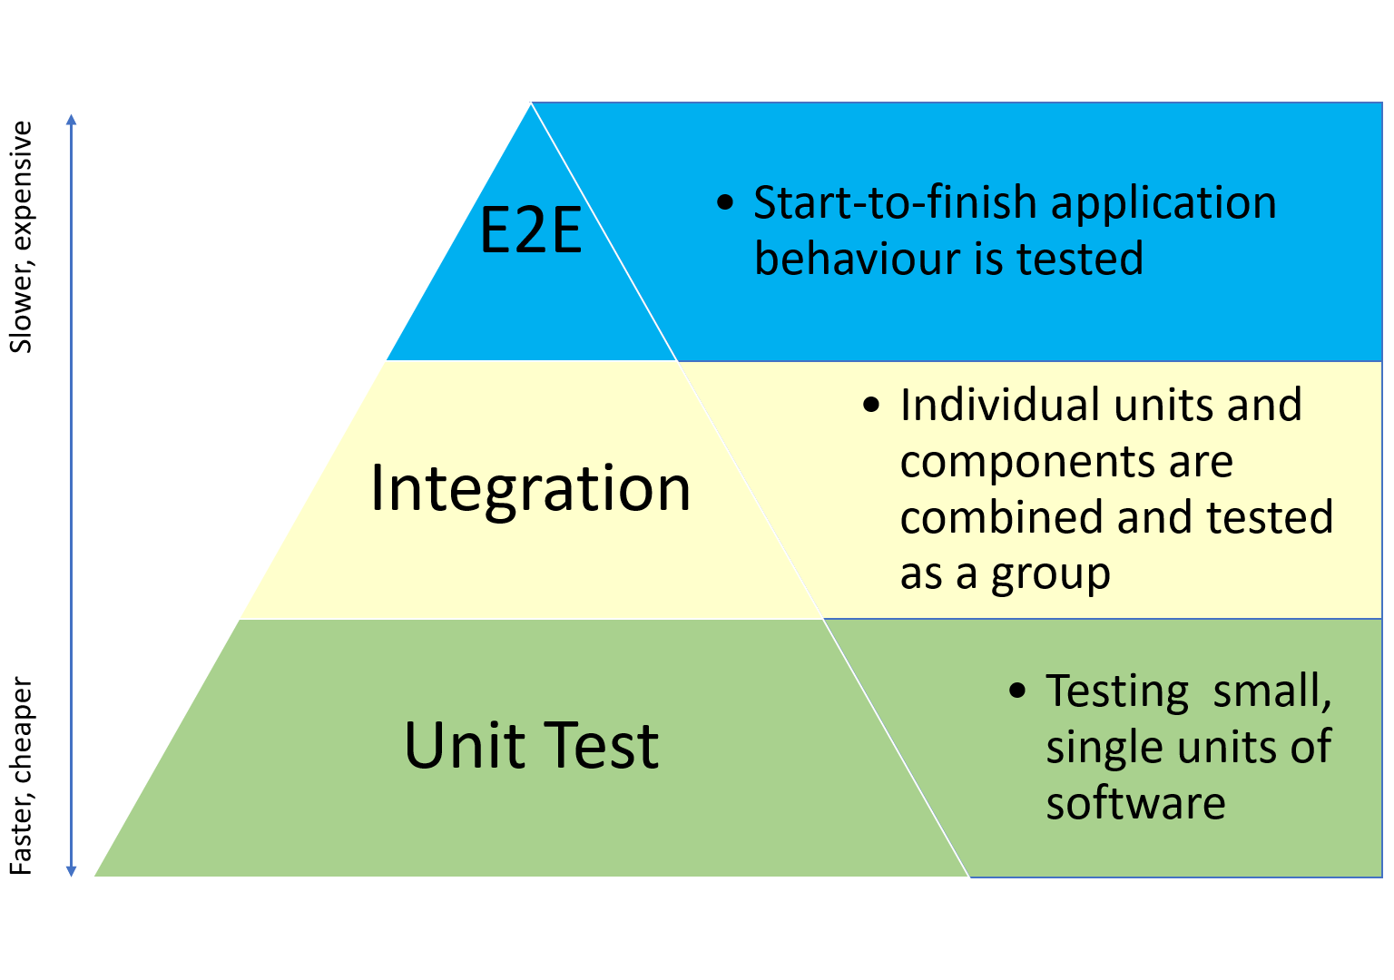
Layers of Testing
Testing Pyramid
Visual framework telling us to think about different layers of testing
Helps both developers and QAs create high-quality software
Reduces the time required for developers to identify a breaking change
Helpful in building a more reliable test suite

Slide 12
Layers of Testing
How much testing should we do?
Tells us (roughly) how much testing to do on each layer
Code base should be majority tests
Many of test cases per feature
Notes:
Logic testing
Defect testing
Exception testing

Slide 13

Layers of Testing
Unit Testing
Assert the operation of individual software components in isolation
Should be able to run extremely quickly and provide fast feedback both while developing and when run in an automated manner
As per the testing pyramid, unit tests should make up the highest percentage of all tests within the project

Slide 14

Layers of Testing
Integration Testing
The level of software testing where individual units / components are combined and tested as a group
Expose faults in the interaction between integrated units

Slide 15

Layers of Testing
System/E2E Testing
Testing an application’s workflow from beginning to end
This method aims to replicate real user scenarios so that the system can be validated for integration and data integrity
Software systems nowadays are complex and interconnected with numerous subsystems. If any of the subsystems fails, the whole software system could crash. This is a major risk and can be avoided by end-to-end testing
Notes:
As per the testing pyramid, these tests should not aim to be exhaustive and test every piece of functionality, as they are usually costly in terms of time to run and can be fragile. Instead, key user journeys (happy and sad path) should be covered to ensure that all components work together.
In other words, System / E2E tests should be applied sparingly and where necessary. They should however be comprehensive enough to ensure that all dependent services are configured correctly, connected and operational.

Slide 16
Test Driven Development (TDD)
What, how, why?

Slide 17
What is TDD?

Slide 18



What is TDD?
Writing a failing test before creating or changing any code

Slide 19
The TDD Cycle
Red, green, factor!
⇨ Write a failing test
⇨ Write the code to make it pass
⇨ Refactor as needed

Slide 20
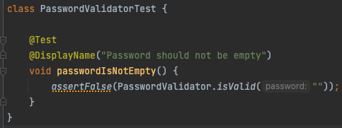
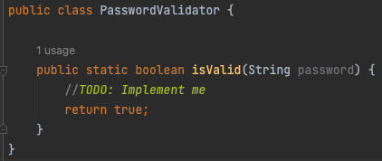
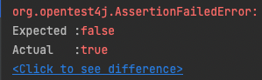
Failing test
Usually
Compiles and runs.
Contains a failing assertion.
But sometimes it requires implementation to even execute (e.g. creating a new method on a class)

Slide 21
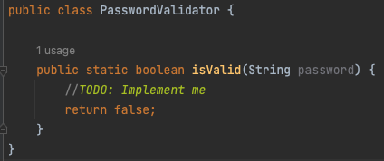
Make it pass
Write just enough to make the test pass.
Be lazy to ensure robust testing.

Slide 22
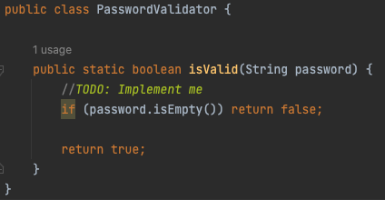
Refactor
A key reason to practice TDD is design.
During the Refactor phase, consider whether you can improve the solution to the existing tests (e.g. make it DRY, decrease coupling)
Don’t
Repeat
Yourself
Notes:
DRY - Don’t Repeat Yourself

Slide 23
The benefits of TDD

Slide 24
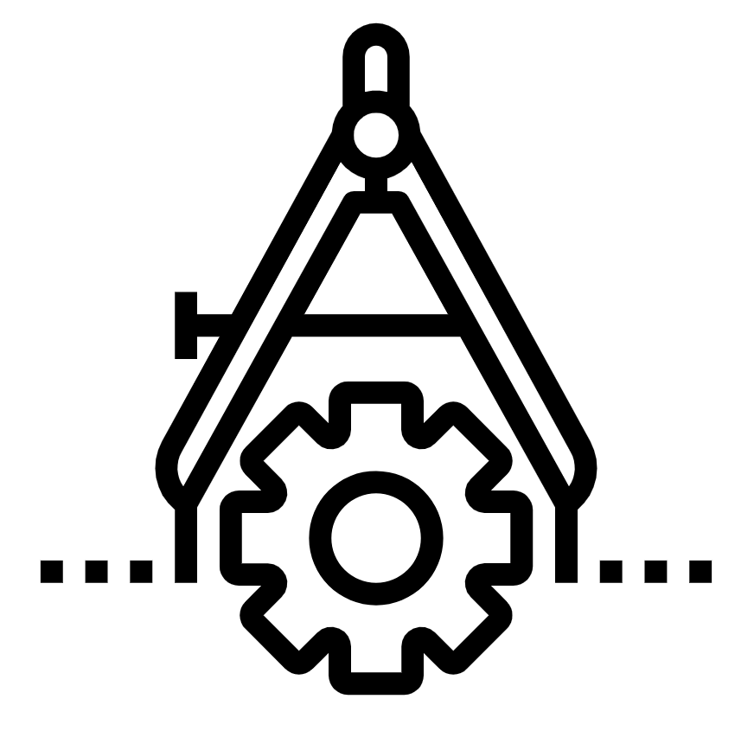
Simpler
Forces us to articulate the exact scope of what we are about to implement rather than meandering
Notes:
Kent Beck says: “Scope creep - It’s easy to get carried away programming and put in code “just in case.” By stating explicitly and objectively what the program is supposed to do, you give yourself a focus for your coding. If you really want to put that other code in, write another test after you’ve made this one work.”
Also precision - one simple test forces precise definition of elemental requirements

Slide 25
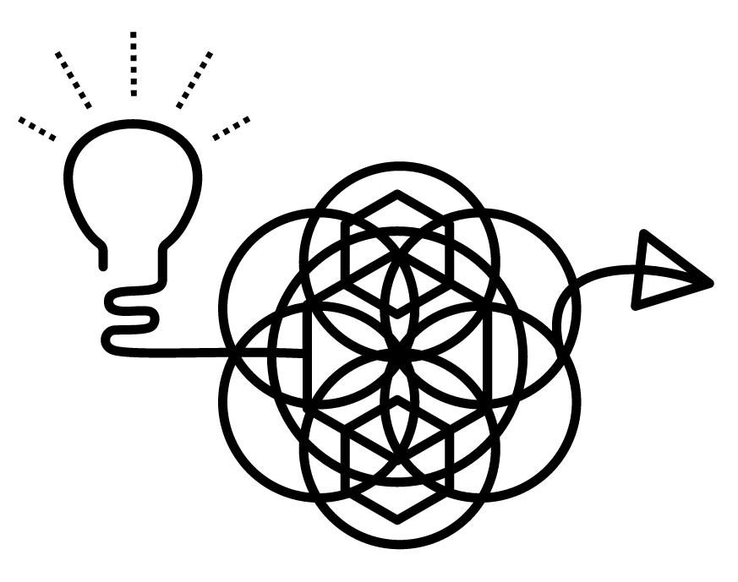
Better design
If it becomes hard to write tests, we know that our design is weak. Writing tests easily reassures us that we have a good design.
Notes:
Kent Beck says: “Coupling and cohesion - If it’s hard to write a test, it’s a signal that you have a design problem, not a testing problem. Loosely coupled, highly cohesive code is easy to test.”
This is fast feedback in action

Slide 26

Communication and trust
Code which we know works, and which has tests documenting the intent, strengthens team working.
Notes:
Kent Beck says: “Trust - It’s hard to trust the author of code that doesn’t work. By writing clean code that works and demonstrating your intentions with automated tests, you give your teammates a reason to trust you.”
Link to pairing here also
At an individual level, pairing develops peoples one-one relationships - the little asides mean pairs get to know each other better
At a team level, knowing that everything has been done by two, implicitly reviewed by two people builds trust.

Slide 27
A working pattern
When you are doing TDD, moving from one task to the next is predictable and efficient.
Notes:
Kent Beck says: “Rhythm - It’s easy to get lost for hours when you are coding. When programming test-first, it’s clearer what to do next: either write another test or make the broken test work. Soon this develops into a natural and efficient rhythm - test, code, refactor, test, code, refactor.”
Refactoring - sometimes you’ll need to to make a new test pass, but often a new, better solution will present itself, making refactoring obvious (and you can do it safely!)

Slide 28
How to write good tests

Slide 29
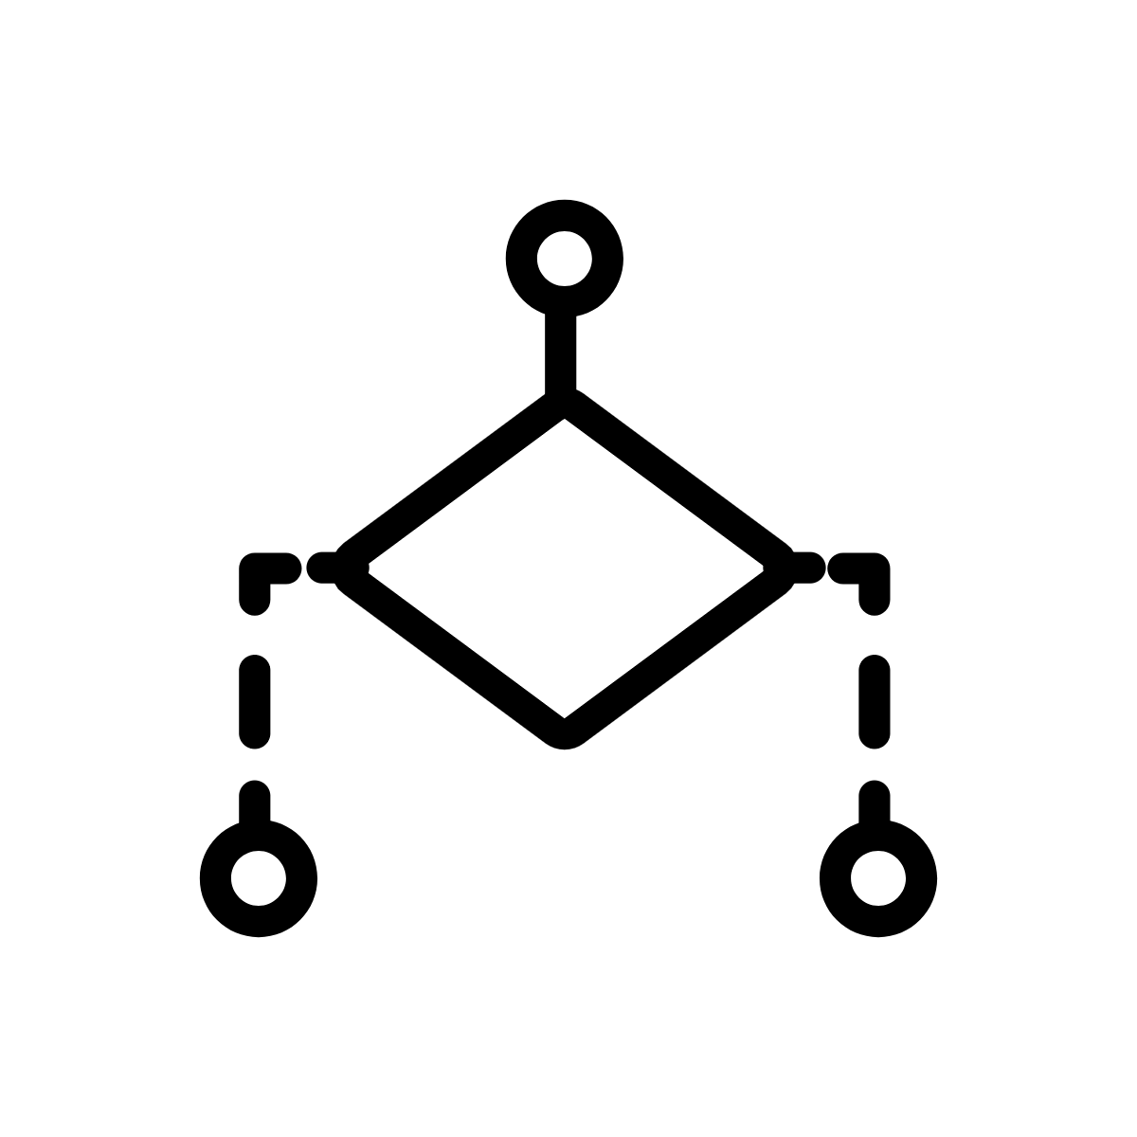
Best practice
Granularity
Each test should cover a single scenario for a single piece of logic.
In practice, a test should first execute a single action against the code (or SUT), then make its assertion(s)
System
Under
Test
Notes:
SUT - System Under Test
Reference: xUnit (http://xunitpatterns.com/SUT.html) , International Software Testing Qualifications Board

Slide 30
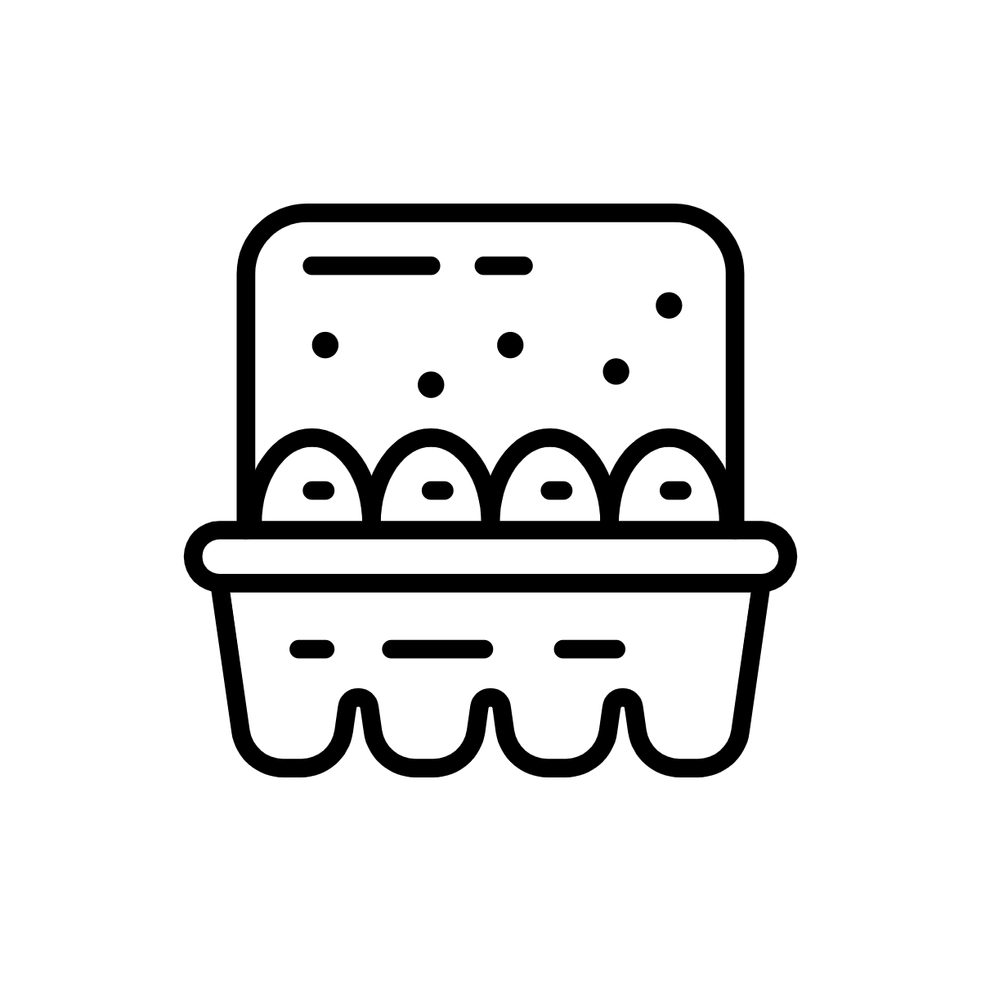

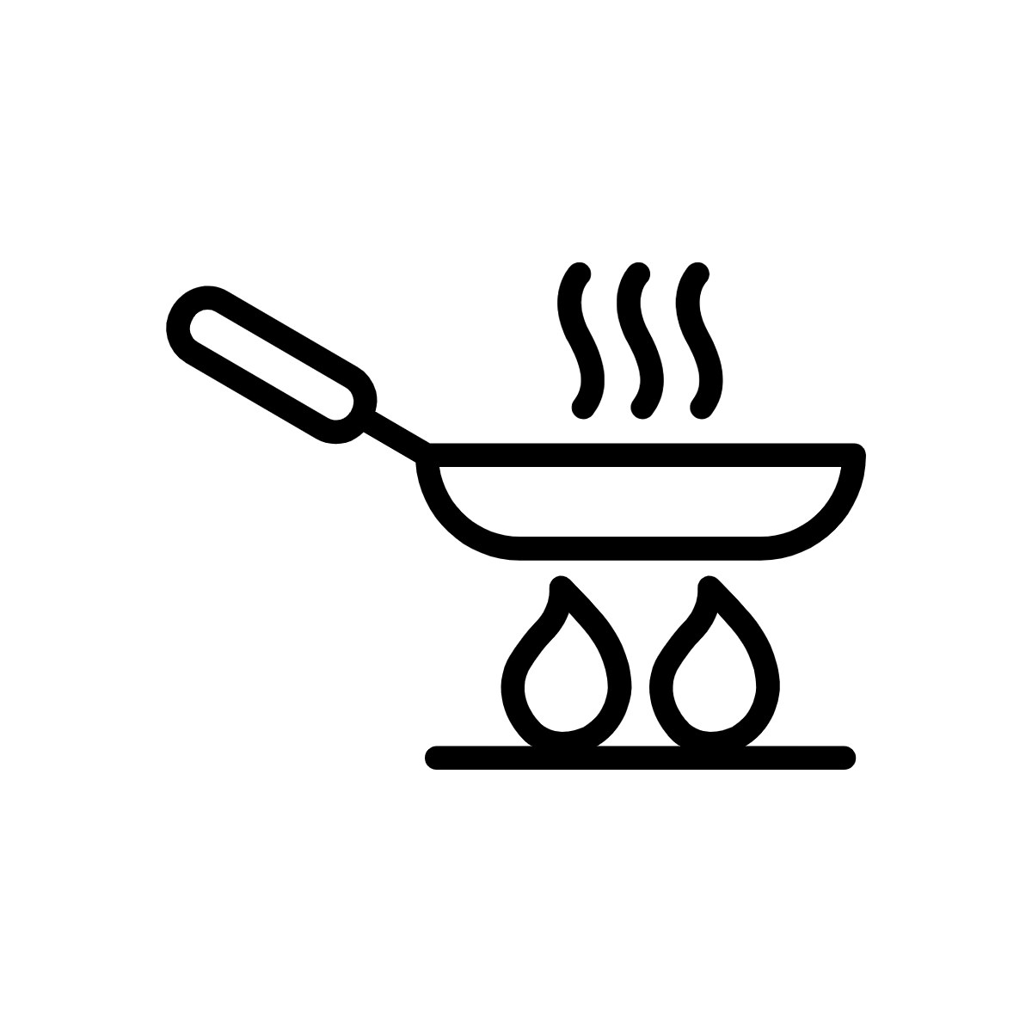

Best practice
What to test
Test business logic (not implementation)
Name your test based on expectations (not implementation)
Test_eggs_should_be_fried()
Notes:
Acknowledge that there is a tension between Granularity (SRP) and “not implementation”
Expectation plus actual == assertion?

Slide 31
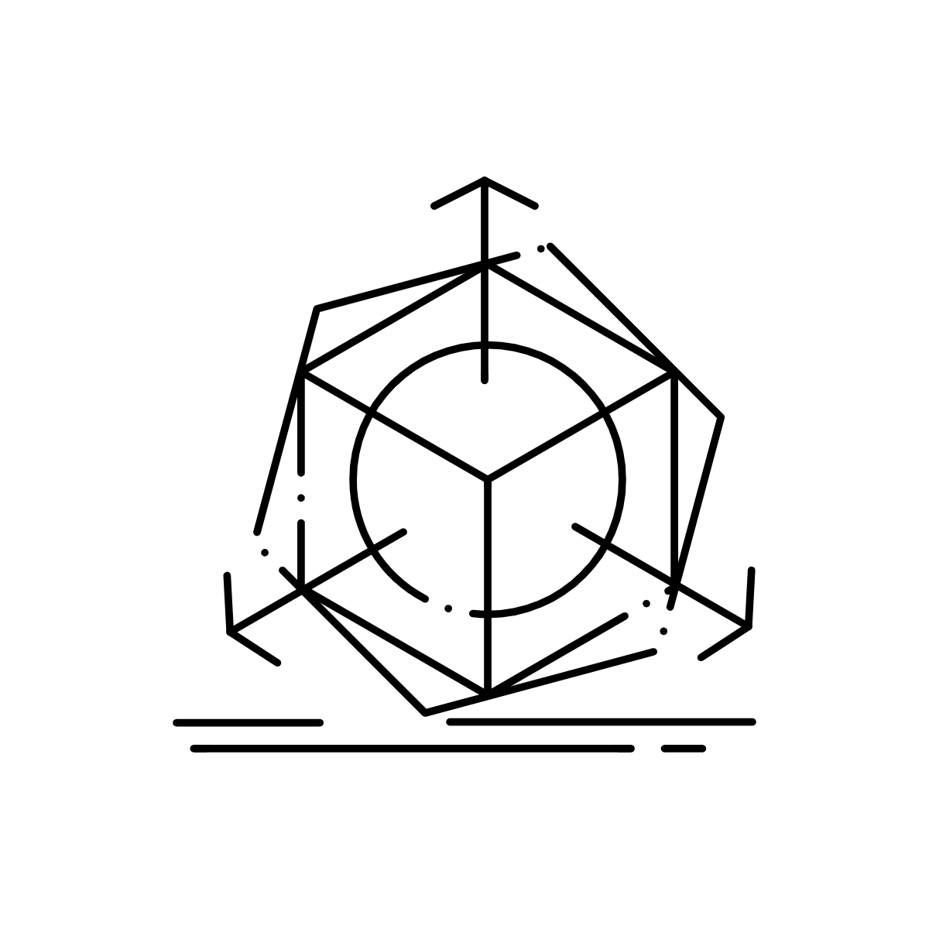
Best practice
Thorough
What should be? (positive tests)
What should not be? (negative tests)
Are there special edge cases?
Any error conditions?
Notes:
Function tests if number is odd:
Positive: Give it three expect true
Negative: Give it two expect false
Edge: How to handle zero
Error: Give it the word elephant

Slide 32

Best practice
Dependable, simple
Must be repeatable and consistent
Design code with no/few dependencies. Avoid special functions just for tests.

Slide 33
TDD - Let’s do it

Slide 34
Summary
Checklist
Hard to write unit tests are telling you your code is bad
Don’t add special “test only” functions
Test inputs and outputs
Make sure you have seen your tests fail at least once

Slide 35
Cheat Sheet: Testing
Tricks and Tips
Hard to write unit tests are telling you your code is bad
Don’t add special “test only” functions
Test inputs and outputs
Make sure you have seen your tests fail at least once
The Words You Use Matter
Your tests are part of the documentation for the next developer. Make sure it explains the functionality of the code with clear examples of behaviour and good test naming
Why Test
Know when you’ve broken something
Improve design
Document the code and behaviour
Key Terms
Unit Test
Assertion
Expectation

Slide 36
The link to BDD
TDD is intended as a more holistic and realistic approach to designing and developing code. Programming linked to customer value
BDD takes this one step further by promoting visibility and shared understanding of customer value realised by a system both within and outside of a development team
Behaviour Driven Development

Slide 37
Automated Testing

Slide 38

Automated Testing
What is test automation?
Practice of running tests automatically, managing test data, and utilizing results to improve software quality
Notes:
The fundamental difference between manual and automated testing is straightforward. With manual testing, a human is responsible for single-handedly testing the functionality of the software in the way a user would. Automated testing is done through an automation tool, so more time can be spent on higher value tasks, such as exploratory tests while automating time-consuming tests, such as regression tests.

Slide 39
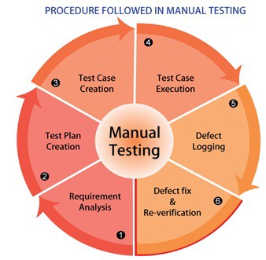
Manual Testing
The process
Notes:
Requirement Analysis - Identify test conditions and design the tests
Test Plan Creation - Determine scope and objectives of testing things like envs and testers
Test case Creation - Develop and prioritise test cases
Test case Execution - Actually running the tests
Defect Logging - Record the feedback of the test
Defect Fix & Re-Verification - Feedback is sent to devs and cycle repeats

Slide 40
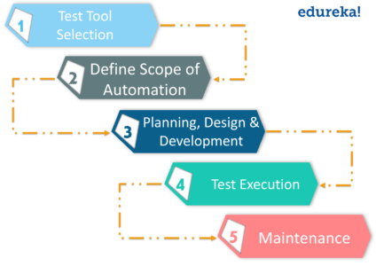
Automated Testing
The process

Slide 41
Benefits of Automated Testing
Cost Effective
The cost of testing your application manually rises over time
Once you’ve created test automation scripts, you can reuse them without additional cost
Initial adoption may be expensive, but it will pay off quickly

Slide 42

Benefits of Automated Testing
Fast Development and Delivery
Automated tests are completed rapidly and can be run repeatedly without human intervention
This increases the speed of development and frees engineers up for critical tasks
Speeding up testing through automation enables:
A shorter software development cycle
Frequent releases
Quicker changes and updates to the app
Faster time-to-market delivery
Notes:
Test automation will help you save your time. Automated tests are completed rapidly and can be run repeatedly. In other words, you don’t have to wait for weeks to execute the tests all over again – just a few hours will be enough.
Thanks to fast test execution and the repeatable nature of tests, automated testing increases the speed of development. Here are some of the advantages you get by speeding up the testing process with automation:
A shorter software development cycle
Frequent releases
Quicker changes and updates to the app
Faster time-to-market delivery
As you can see, switching from manual testing to automation will reduce the waiting time and boost your development.
Automated tests don’t require any human intervention while running, meaning that you can test your app at nighttime and harvest the results the next morning. Because automated tests can run repeatedly on their own, software developers and QAs are able to spend less time on testing. Basically, with automation, your engineers can focus on critical tasks. Everyone knows that fixing the existing app functionality is not as exciting as creating new features.

Slide 43

Benefits of Automated Testing
High App Quality and Performance
Run many automated test cases simultaneously
Create many test cases quickly, including complex and the lengthy ones
Error-free releases are more likely as automated testing is more accurate* than manual testing
Notes:
Thanks to the extensive test coverage, automated testing will ensure your app’s high quality and performance. It allows you to run thousands of automated test cases simultaneously, so you can easily test your app against multiple platforms, on several devices at a time. And if you want to make the most out of test parallelism and concurrency, go for cloud-based device farms. They can help you cover all the required variants of OS and hardware configurations.
What’s more, with automated testing, you can create many test cases quickly, including the complex and the lengthy ones. This is something you can never do if you choose to test your app manually.
*Assuming the tests are well designed.
With test automation, you are more likely to have error-free releases. Thanks to minimized human intervention, automated testing is more accurate than testing applications manually. The thing is, a human tester can make mistakes during any step of evaluation. But the machine won’t. Generated test cases are more precise than human testers, which means that by eliminating human errors, you will reduce the risk of failure.
If you want to unleash the full potential of test automation accuracy, try working with an AI Testbot. It’s an artificial intelligence-powered solution that can perform exploratory testing even better than humans.

Slide 44
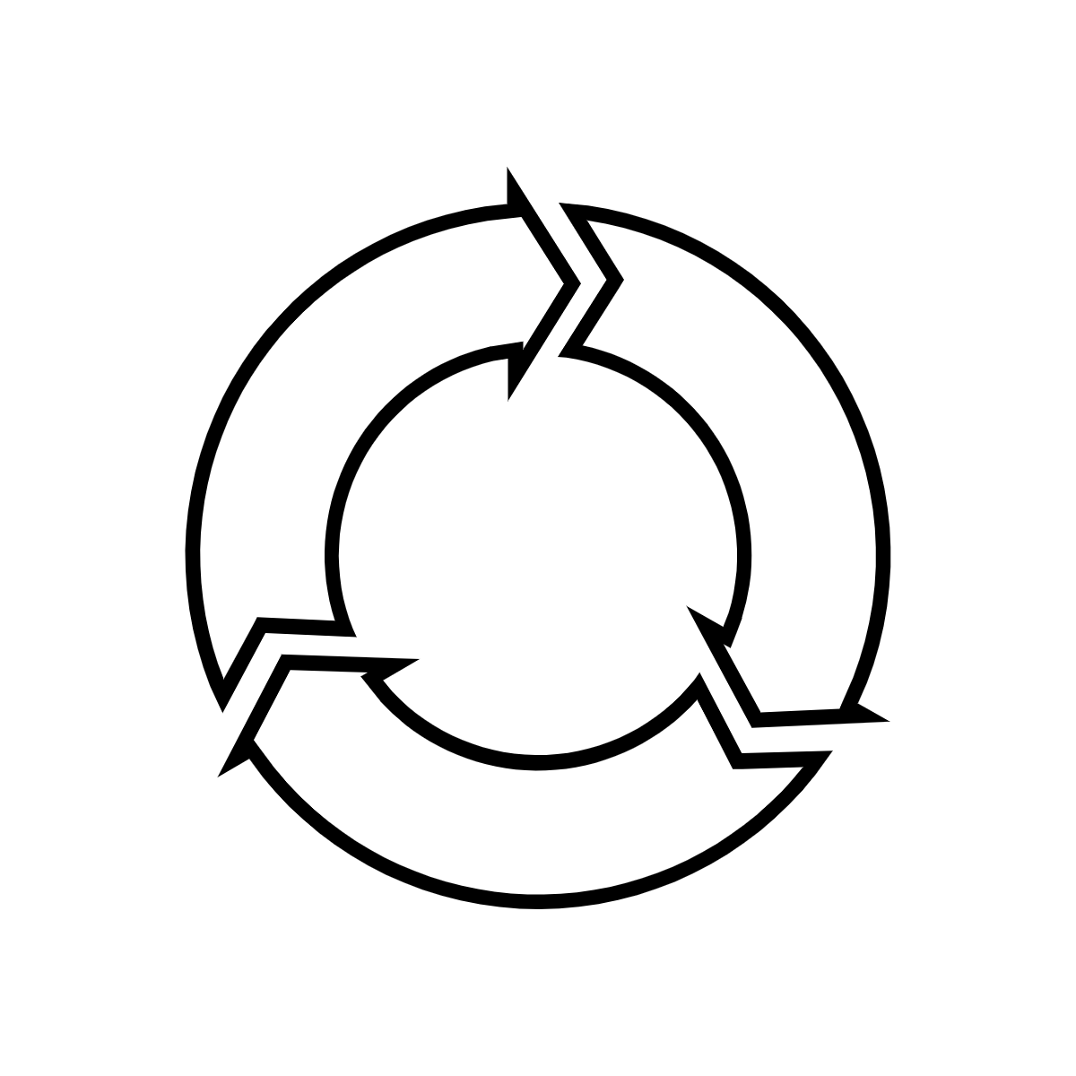
Benefits of Automated Testing
Immediate Feedback
Fast test execution generates testing reports instantly, so whenever a failure occurs, developers react to it quickly.
Immediate feedback is especially useful when your software is already in use. If you need to fix some bugs quickly, manual testing will only slow the process down.
Helps you make quick updates to your application. As a result, automated testing brings high team responsiveness, better user experience and higher customer satisfaction.
Notes:
Another benefit of automated testing is instant feedback. With fast test execution, developers get testing reports instantly, so whenever a failure occurs, they will react to it quickly. Forget about struggling to decipher the code written three weeks ago.
Immediate feedback is especially useful when your application is already on the market. If you need to fix some bugs quickly, manual testing will only slow the process down. By contrast, test automation will help you make quick updates to your application. As a result, automated testing brings high team responsiveness, better user experience and higher customer satisfaction.

Slide 45
Automated Testing
Examples
MOD web application
Overnight 7 hour suite of regression tests
80% test automation
~60% of code base contained tests

Slide 46

Criteria for Test Automation
Repeatable
Automation of a test that can only be run once is not helpful.
A repeatable test has the following three steps:
Set up the test, data and environment
Execute the function and measure the result
Clean up the data and environment
Notes:
In the first step, we want to be able to put the environment into a consistent state. In other words, if we have a test for attempting to add an existing user, we need to make sure the user exists before performing the test. Once the test is complete, the environment should be returned to the base state

Slide 47
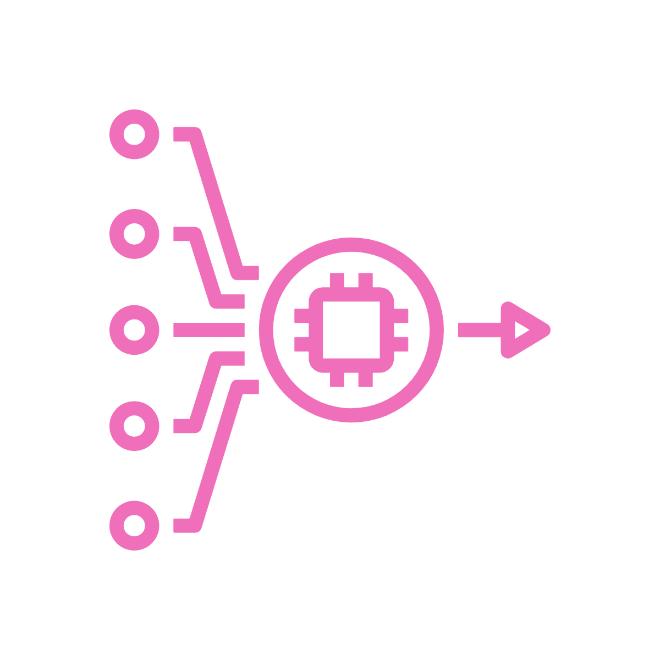
Criteria for Test Automation
Determinant
When a function is determinant, it means that the outcome is the same every time it’s run with the same input. The same is true of tests that can be automated
Running tests in parallel may cause unexpected results. For example, creating a new user would add to the total number of users. Isolating tests from other tests can prevent this kind of false positive.
Notes:
When a function is determinant, it means that the outcome is the same every time it’s run with the same input. The same is true of tests that can be automated. For example, say we want to test an addition function. We know that 1 + 1 = 2 and that 394.19 + 5.81 = 400.00. Addition is a determinant function.
Software, on the other hand, may use such a high number of variable inputs that it’s difficult to have the same result over time. Some variables may even be random, which may make it difficult to determine the specific outcome. Software design can compensate for this by allowing for test inputs through a test harness.
In software testing, a test harness or automated test framework is a collection of software and test data configured to test a program unit by running it under varying conditions and monitoring its behavior and outputs. It has two main parts: the test execution engine and the test script repository.
Test harnesses allow for the automation of tests. They can call functions with supplied parameters and print out and compare the results to the desired value. The test harness is a hook to the developed code, which can be tested using an automation framework.
A test harness should allow specific tests to run (this helps in optimizing), orchestrate a runtime environment, and provide a capability to analyse results.
Other features of an application may be additive; for example, creating a new user would add to the number of users. At least when we add a user we know that the number of users should only grow by one. However, running tests in parallel may cause unexpected results. Isolation can prevent this kind of false positive.
Tests should be isolated from other tests.

Slide 48

Criteria for Test Automation
Unopinionated
You cannot automate matters of opinion. This is where usability testing, beta testing, and so forth really shine. User feedback is important, but it can’t really be automated.
Notes:
In the first step, we want to be able to put the environment into a consistent state. In other words, if we have a test for attempting to add an existing user, we need to make sure the user exists before performing the test. Once the test is complete, the environment should be returned to the base state

Slide 49
Automated Testing - Let’s do it

Slide 50
What can we automate?
Everything
Code Analysis Unit Tests Integration Tests Automated Acceptance Tests Regression Tests Performance Tests Smoke Tests
Notes:
Code Analysis
There are actually many different types of code analysis tools, including static analysis and dynamic analysis. Some of these tests look for security flaws, others check for style and form. These tests run when a developer checks in code. Other than configuring rules and keeping the tools up to date, there isn’t much test writing to do with these automated tests.
Unit Tests
You can also automate a unit test suite. Unit tests are designed to test a single function, or unit, of operation in isolation. They typically run on a build server. These tests don’t depend on databases, external APIs, or file storage. They need to be fast and are designed to test the code only, not the external dependencies.
Integration Tests
Integration tests are a different kind of animal when it comes to automation. Since an integration test—sometimes called end-to-end tests—needs to interact with external dependencies, they’re more complicated to set up. Often, it’s best to create fake external resources, especially when dealing with resources beyond your control.
If you, for example, have a logistics app that depends on a web service from a vendor, your test may fail unexpectedly if the vendor’s service is down. Does this mean your app is broken? It might, but you should have enough control over the entire test environment to create each scenario explicitly. Never depend on an external factor to determine the outcome of your test scenario.
Automated Acceptance Tests
There are several practices today that use automated acceptance tests (AAT), but they’re basically doing the same thing. Behavior-driven development (BDD) and automated acceptance test-driven development (AATDD) are similar. They both follow the same practice of creating the acceptance test before the feature is developed.
In the end, the automated acceptance test runs to determine if the feature delivers what’s been agreed upon. Therefore, it’s critical for developers, the business, and QA to write these tests together. They serve as regression tests in the future, and they ensure that the feature holds up to what’s expected.
Regression Tests
Without AATs in place, you have to write regression tests after the fact. While both are forms of functional tests, how they’re written, when they’re written, and whom they’re written by are vastly different. Like AATs, they can be driven through an API by code or a UI. Tools exist to write these tests using a GUI.
Performance Tests
Many kinds of performance tests exist, but they all test some aspect of an application’s performance. Will it hold up to extreme pressure? Are we testing the system for high heat? Is it simple response time under load we’re after? How about scalability?
Sometimes these tests require emulating a massive number of users. In this case, it’s important to have an environment that’s capable of performing such a feat. Cloud resources are available to help with this kind of testing, but it’s possible to use on-premises resources as well.
Smoke Tests
What’s a smoke test? It’s a basic test that’s usually performed after a deployment or maintenance window. The purpose of a smoke test is to ensure that all services and dependencies are up and running. A smoke test isn’t meant to be an all-out functional test. It can be run as part of an automated deployment or triggered through a manual step.

Slide 51
Behaviour Driven Development (BDD)
What, how, why?

Slide 52
What is BDD?
Behaviour-Driven Development (BDD) is a test-first testing practice that tests the system’s behaviour from an end user’s perspective.
BDD is a set of regular activities designed to:
Encourage collaboration between business people and developers
Produce system documentation that is automatically checked against the system’s behaviour
Notes:
Behaviour-Driven Development (BDD) is a test-first testing practice that tests the system’s behaviour from an end user’s perspective. BDD is also referred to as Specification by Example.
BDD is a way for software teams to work that closes the gap between business people and technical people by:
Encouraging collaboration across roles to build shared understanding of the problem to be solved
Producing system documentation that is automatically checked against the system’s behaviour
Adopting BDD can help to reduce miscommunication of requirements and waste, and is particularly advantageous where there is a lot of complexity in the problem and solution spaces.

Slide 53
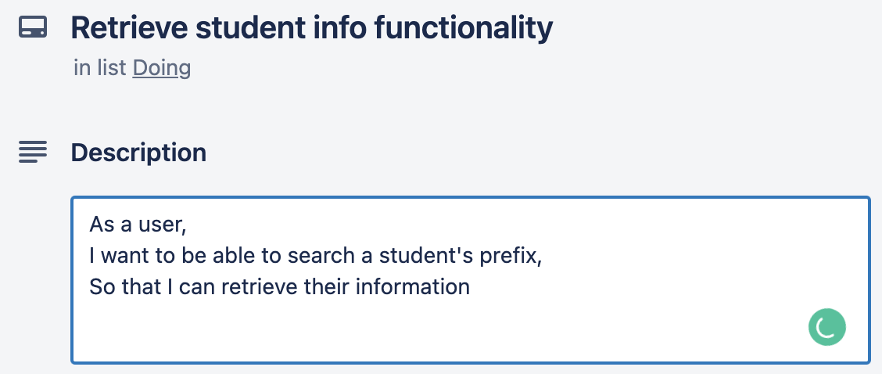
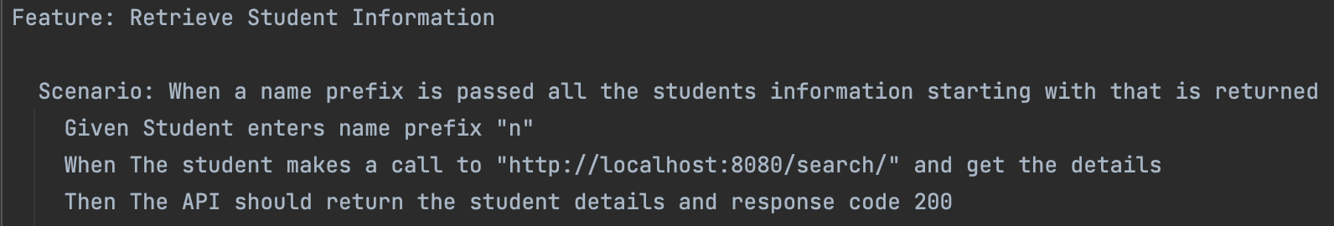
What is BDD?
Notes:
At its core, BDD is a way of working that facilitates communication between humans
The primary goal of behaviour driven development is to solve the problem of communication between the business interests, the engineering team, and the machines. It helps everyone understand, even the non-technical team members, what is going on in the project.
The aim of behaviour driven development is to reduce the cost of translation between these entities.

Slide 54



The BDD Phases
Discovery
Work out what the tests should be
Formulation
Convert discovery items into test cases
Automation
Automate the test cases

Slide 55

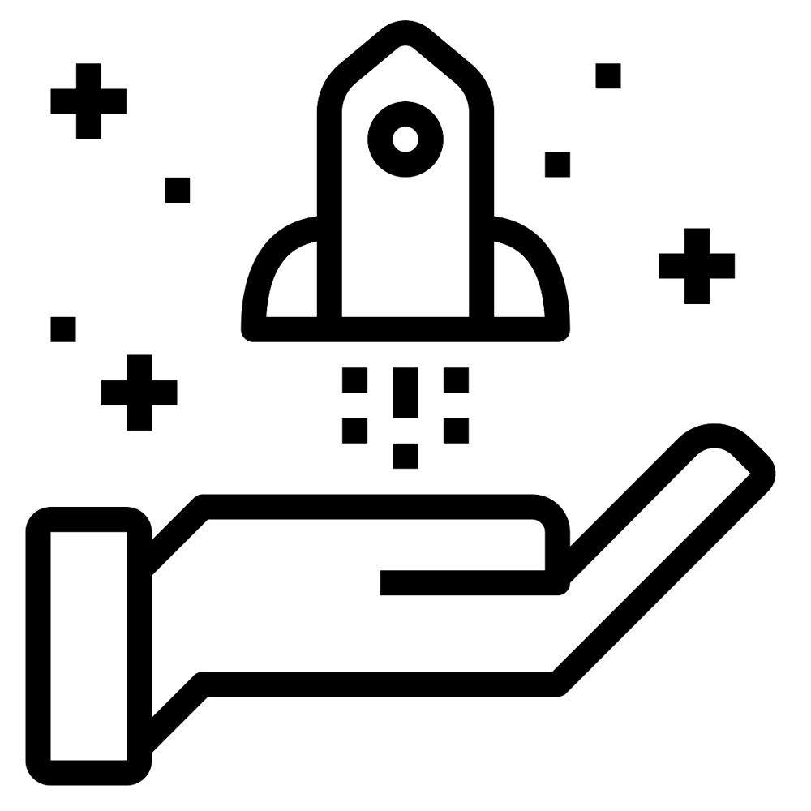
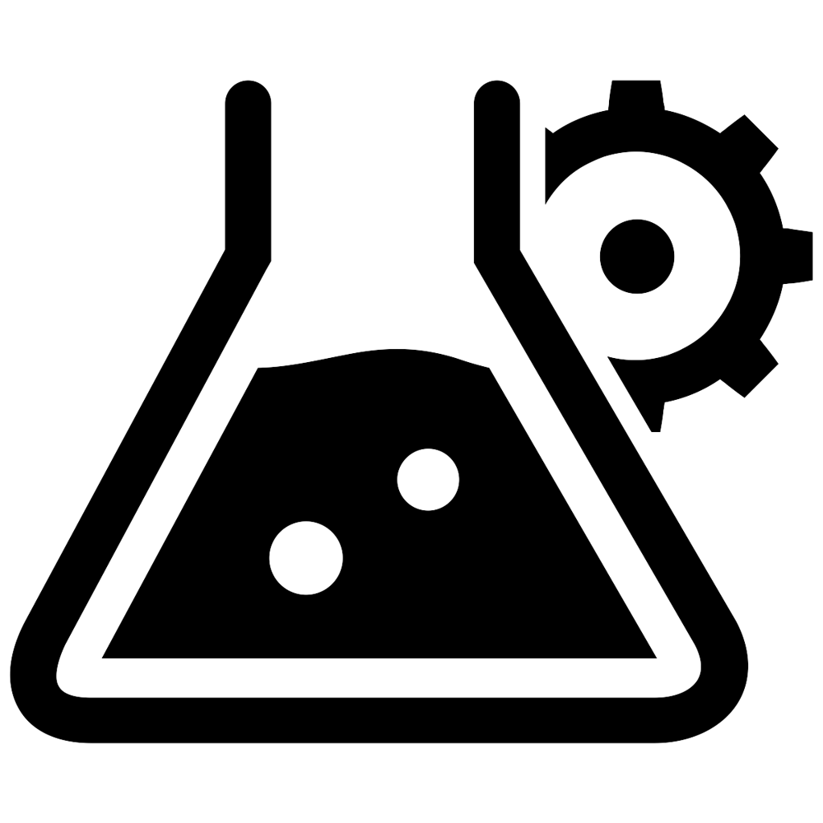

Three Amigos
Business
Test
Developer
Considers the customer needs
Ensures edge cases are considered
Advocates for implementation
Notes:
Three amigos refers to the primary perspectives to examine an increment of work before, during, and after development. Those perspectives are:
Business – What problem are we trying to solve?
Development – How might we build a solution to solve that problem?
Testing – What about this, what could possibly happen?
People holding these different perspectives should collaborate to define what to do, and agree on how they know when it is done correctly. The end result of such a collaboration results in a clearer description of an increment of work often in the form of examples, leading to a shared understanding for the team.
Expected Benefits
Builds a shared understanding about the intent of an increment of work.
Identifies misunderstandings and confusion early and allows learning to happen sooner in the delivery of an increment of work.
Provides a reasonable guard rail for the number of people who should be involved in discussions about any given increment of work.

Slide 56


Example Mapping
Before you pull a user story into development, it’s crucial to have a conversation to clarify and confirm the acceptance criteria.
Example mapping is a way of working out and gaining clarity around the specifications of a scenario using examples.
It is based on the idea that multiple examples of specific cases explain information better than a single bad abstraction of a concept.

Slide 57
Example Mapping
Story
Question
Rule
Rule
Rule
Question
Example
Example
Example
Question
Example
Example

Slide 58
Example Mapping
FizzBuzz
What if it’s divisible by 5 and 3?
Not Divisible By 5 or 3
Divisible by 3, print Fizz
Divisible by 5, print Buzz
What is the range of numbers? 1-100?
Input 1 => Print “1”
Input 6
=> “Fizz”
Input 5
=> “Buzz”
Invalid data? E.g. Not a number?
Input 2
=> Print “2”
Input 10
=> “Buzz”

Slide 59
TDD Cycle

Slide 60
BDD Cycle

Slide 61



BDD Cycle
In the beginning, there was nothing. The only time code is clean, and there are no bugs

Slide 62
BDD Cycle
First we write a failing external test, it will require a lot of code to make work

Slide 63
BDD Cycle
Next we write the first failing Unit Test, it will require little code to make pass

Slide 64
BDD Cycle
Next we make the test pass

Slide 65
BDD Cycle
Then we refactor

Slide 66
BDD Cycle
Eventually the unit tests makes the outer test pass

Slide 67
BDD Cycle
The outer loop passing is the same as implementing the code in the unit test

Slide 68
BDD Cycle
And move onto the next failing outer test

Slide 69
Scenarios - Gherkin
‘Given-When-Then’ formula
Gherkin uses a set of special keywords to give structure and meaning to executable specifications.
This is the proposed template for writing BDD test cases for a user story, which can be defined as:
Given a certain scenario
When an action takes place
Then this should be the outcome
A practical example would be:
Given I type “5” into fizzbuzz
When I press submit
Then I should see the word “buzz”

Slide 70
Feature File
Structure
A feature is a topmost section in the file and will start with the ‘Feature’ keyword. It consists of the test case title and a description.
Inside the feature we have scenarios. These are a collection of statements using the ‘Given-When-Then’ keywords which illustrates the test cases. A feature file can have multiple scenarios.
A practical example would be:
Feature: Get the customer based on id
As a service
I want to get the customer details
So that I can check whether they exist.
Scenario: Fetching existing customer
Given customer "Nicole Forsgren" with ID "12345" exists
When I fetch customer "12345"
Then I should see customer "Nicole Forsgren"

Slide 71
How does this magic get executed?
Feature: Get the customer based on id
As a service
I want to get the customer details
So that I can check whether they exist.
Scenario: Fetching existing customer
Given customer "Nicole Forsgren" with ID "12345" exists
When I fetch customer "12345"
Then I should see customer "Nicole Forsgren"

Slide 72
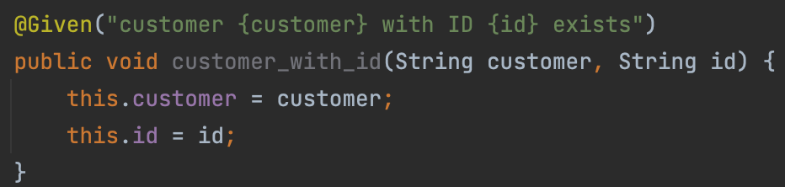
How does this magic get executed?
Given customer "Nicole Forsgren" with ID "12345" exists
Matches the annotation
Notes:
This is python btw

Slide 73
BDD - Let’s do it

Slide 74
How do we automate BDD?
There exist many BDD test automation frameworks for most mainstream programming languages.
The frameworks will read the Feature Files (see previous slides) and validate that the code does what those specifications promise

Slide 75





BDD frameworks
Java - CucumberJVM
Python - behave
Go - GoDog, ginkgo
.NET - SpecFlow
JS - Cucumber.js

Slide 76

TDD vs. BDD
Trick question
They’re not diametrically opposing
They complement each other
You could do one or other
But we recommend doing both
‘Cos they’re like two peas in a pod
TDD
BDD
BFFs
Notes:
The content is animated, so ask the audience the question and see what they respond with
Then hit ‘em with the ol’ trick question :)

Slide 77
Risk and Rewards
Risks
Upfront cost - BDD is a “left-shift” exercise, so more development cost is incurred upfront
Inadequate communication - Communications between the user and the developer are essential, if the user if not available, it will be difficult to work past ambiguities and questions generated by the user stories
Feasibility - BDD requires complete specification up-front which is not always feasible
Rewards
Inclusion - Everyone from the customer to the tester should be able to easily engage in product development. Anyone can write behavior scenarios
Clarity - Scenarios focus on the expected behaviors of the product
Streamlining - Scenarios are requirements, acceptance criteria, test cases, and test scripts all in one
Shift Left - Testing earlier means fewer bugs later. In BDD, test case definition inherently becomes part of the requirements phase
Artifacts - Scenarios form a collection of self-documenting test cases as a result of the BDD process
Test-Driven - Writing scenarios from the beginning enforces quality-first and test-first mindsets
Code Reuse - Given-When-Then steps can be reused between scenarios. Automation code becomes very modular.
Momentum - Snowball effect: scenarios become easier and faster to write and automate as more step definitions are added
Adaptability - BDD scenarios are easy to update as the product changes. Plain language is easy to edit. Modular design makes changes to automation code safer
Communication - BDD forces business people and devs to talk to each other

Slide 78
Terms and other things to know
Story – A description of a software feature that describes the required functionality from the user’s perspective
Feature – A unit of functionality within an application that carries out a particular action for the end-user
Scenario – Practical, real-world description of a feature in terms of a starting condition, some actions to be carried out and an expected outcome. Structured by beginning the statements with the terms “Given”, “When” and “Then”, respectively
Gherkin – a format used to specify scenarios according to a formal structure, which is imposed by the use of the following key terms: Given, When, Then, And, But
Step - A Step Definition is a code block with an expression that links it to one or more Gherkin steps
Feature File – The description, requirements, acceptance criteria, test case definition and scripts (for automation) for the corresponding feature
Ubiquitous’ language - Providing a common technical vocabulary and grammar that is understood by all participants. This way, business analysts, testers, developers are more likely to be all on the same page, sharing a common understanding, when requirements are being discussed

Slide 79

Cheat Sheet: BDD
BDD Phases
Discovery
This is where you get together in your 3 Amigos group. You come together to work out what the tests should be.
Formulation
This is where you convert the things discovered in discovery into something you can use more directly in tests. This might be using Gherkin (feature files), or it might not!
Automation
This is where you take your finalised steps and automate their execution. You might use behave or cucumber to do this!
3 Amigos
3 hats are better than one! In this meeting you come together with someone representing
Business
Considers the customers needs
Testing
Uses their heuristic toolkit to ensure edge cases are considered
Development
Advocates for the implementation.
You don’t literally need these people here, just people wearing their hats!

Slide 80
Other types of Testing

Slide 81
Other types of Testing
Smoke Testing
Software testing process that determines whether the deployed software build is stable or not
Used to test key user journeys to ensure that a deployment has been successful and that all dependent systems are configured before running

Slide 82
Other types of Testing
Synthetic monitoring / Synthetics
Used to monitor a live system by simulating real user activity against a given application
Incredibly useful for continuously testing an application and asserting its operation
System / E2E tests are still useful and required to test platforms and applications via automated testing and can be used in conjunction with Synthetics to continuously ensure that a system is operating correctly during and after deployment.

Slide 83
Other types of Testing
Code quality, static analysis and linting
Before starting the functional testing, the codebase should be scanned for styling / formatting issues, unused or missing imports, cyclomatic complexity and anything else that can be caught by these types of tests

Slide 84
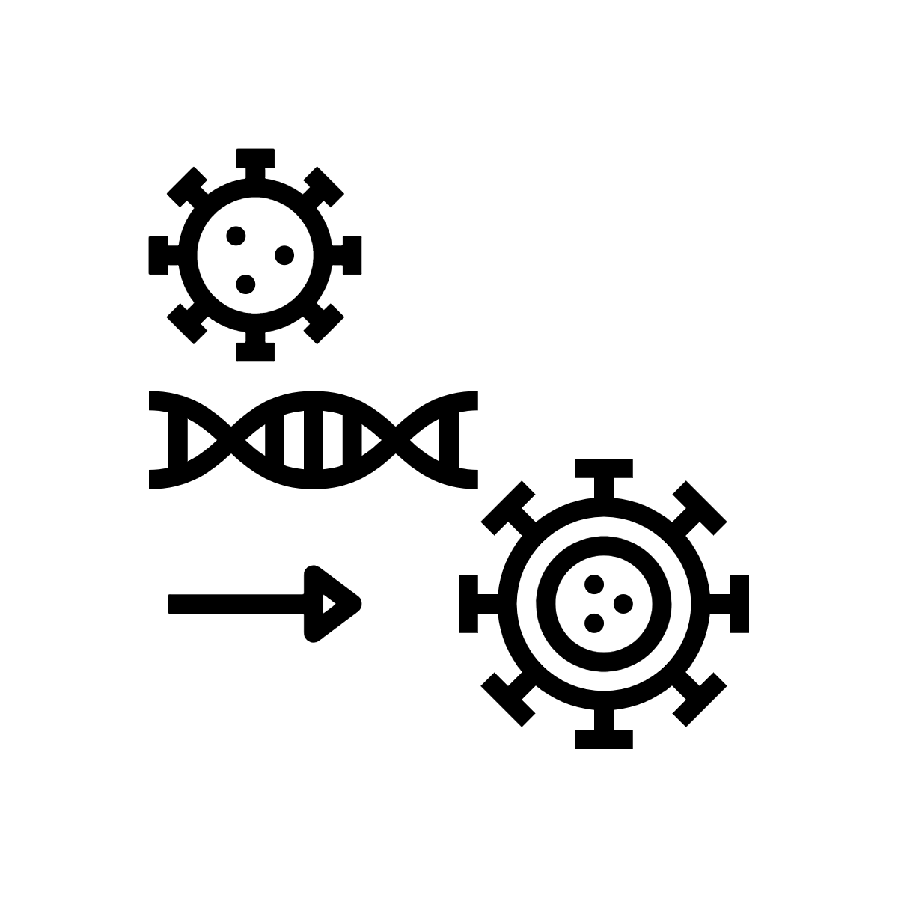
Other types of Testing
Mutation Testing
Useful to check that existing tests (typically unit tests) have been implemented in a way that will detect changes to the functionality
Mutation testing frameworks make copies of the code with minor changes to the implementation and then run the existing tests against both the original and the copy.
If the result of the tests is the same for both the original and the mutation, then there is an issue, because the test will have failed to detect the change.
If the results are different, the test is deemed successful as it will have caught the mutation.
Notes:
Downsides:
The major downside to mutation testing is that it is extremely time consuming. If the codebase is of a reasonable size, then there will be a large number of generated mutations. Given this limitation, mutation tests should not be performed on every single commit, but instead should be run regularly, with the aim of improving the mutation score over time.

Slide 85

‹#›

